Slide 1
TFM DL Tools for Finance Application Transfert Learning Vgg16sp500
I Miled 2019 2020

Slide 2
Objective
The objective of the transposition of deep learning methodology to finance was to focus on:
1. classification of current/future of market/economic state
2. prediction of future price
3. construction of investment strategies
4. risk estimation
5. process news flow to assess market sentiment

Slide 3
Problem of validity of Technical analysis
In any case, for this TFM I will focus deeper only on one specific problem
Technical Analysis which a methodology for forecasting the direction of prices through the study of past market data, primarily price and volume.
The ground of this theory comes from behavioral economics and quantitative analysis, which stands in contradiction of much of modern portfolio theory and market valuation.

Slide 4
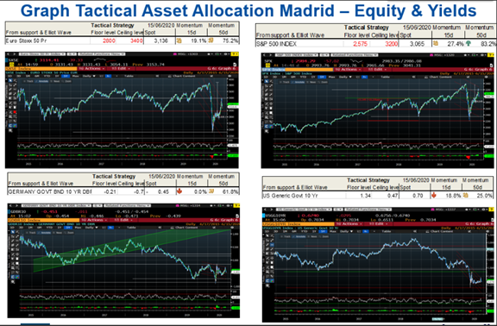

Slide 5
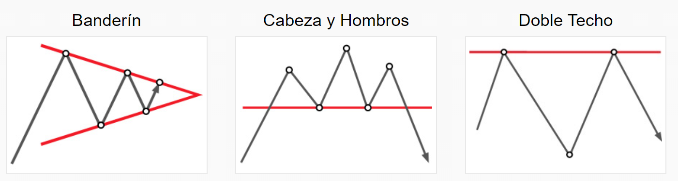
Example of standard figures
su
Source https://www.instaforex.com/sp/techanalysis

Slide 6
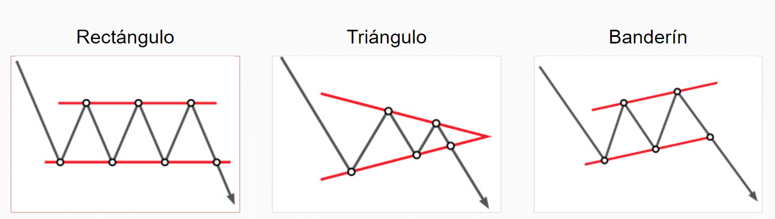
Example of standard figures
su
Source https://www.instaforex.com/sp/techanalysis

Slide 7
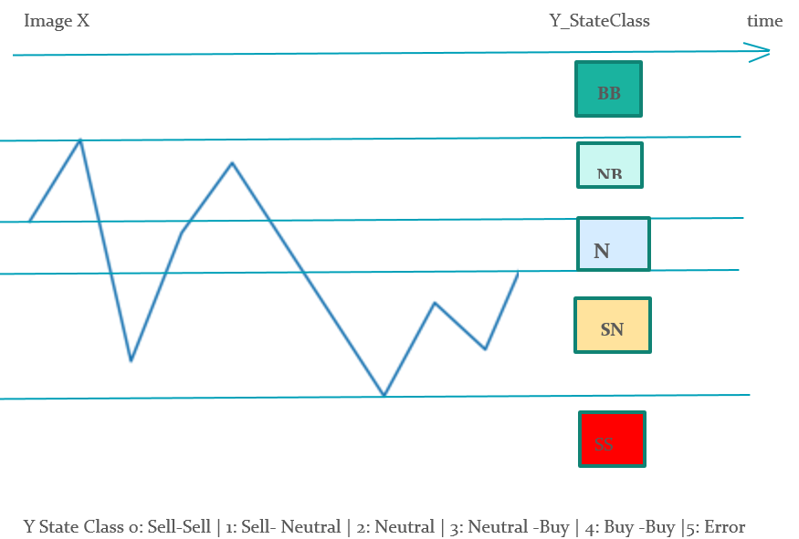
Dataset construction

Slide 8
Choice of datas
Market considerations
Liquidity
History
Number of participants
Reference
Also I selected the American equity index SPX 500 for this project as it is the most liquid equity indices where many operators can interact from retail to institutional investors. Moreover the index has a long history that I see from 1927. Also the index price are quoted every working day.

Slide 9
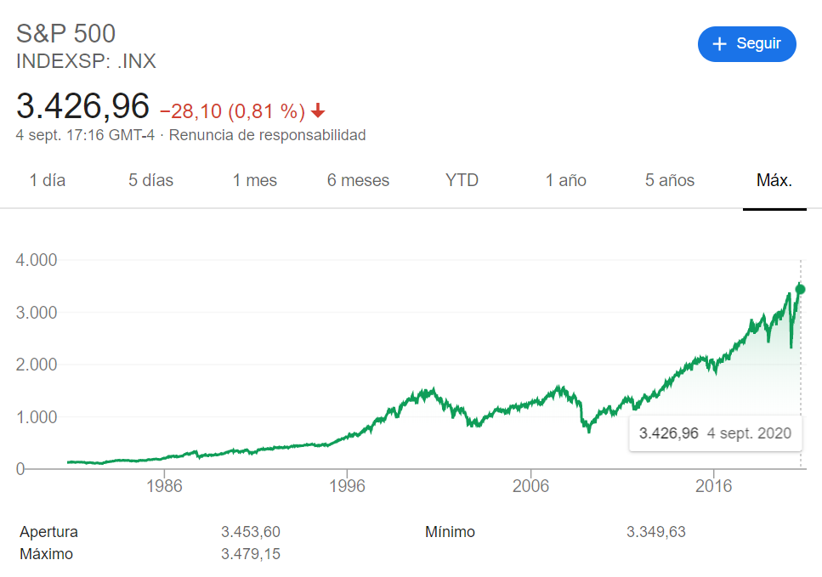
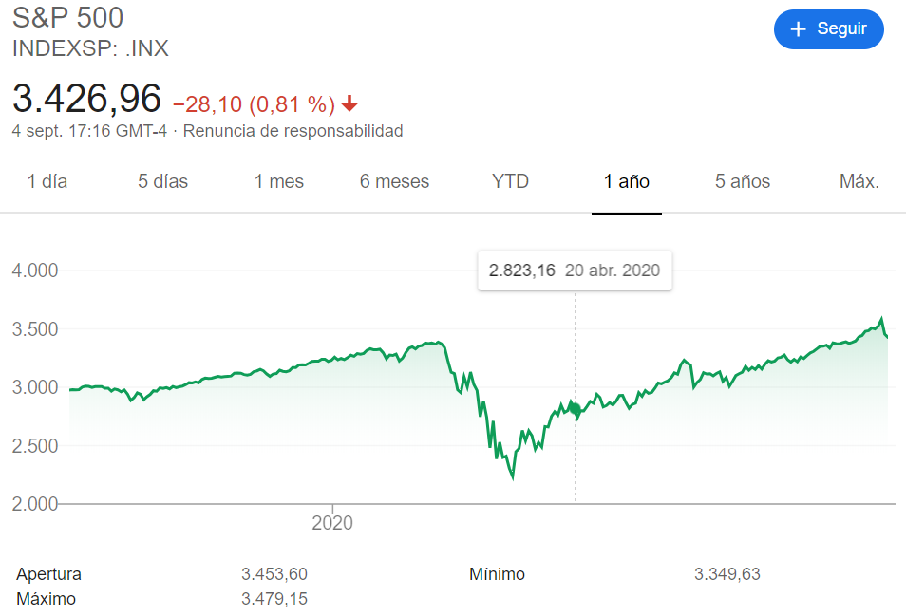
Source google

Slide 10
Dataset Construction
The historical datas are downloaded through yahoo API
I splited the datas in 4 np.array group x_train, x_test and y_train, y_test owith a total of 23254 images and 23254 state
Input history 25 past days of 32 x 32 x3 np array
Future state 5 next days for 6 states between -1 and 4
Sell-Sell | Sell- Neutral | Neutral | Neutral -Buy | Buy -Buy | Error
NB: on split on time horizon minute day week month years

Slide 11
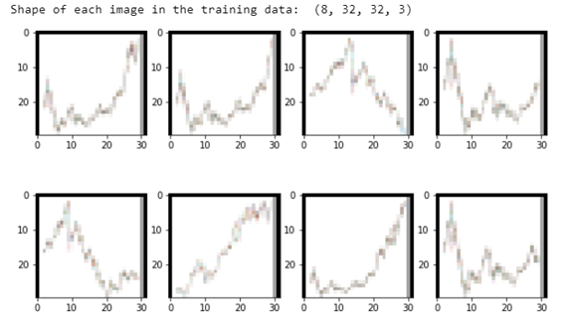

Slide 12
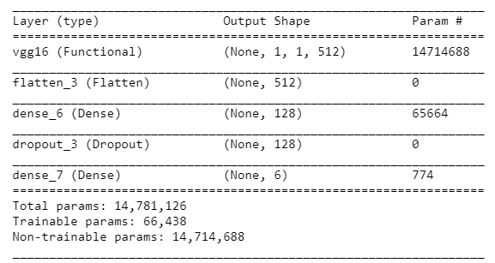
Description of the methodology and tools used
Colab, Tensorflow Keras, Transfert Learning Vgg16
batch_size=[25,50,100]
epochs=[25,50,100]
learning_rate=[0.001,0.01,0.1]
optimizer_name= SGD, RMSprop, Adam, Adagrad, Adamax, Ftrl

Slide 13
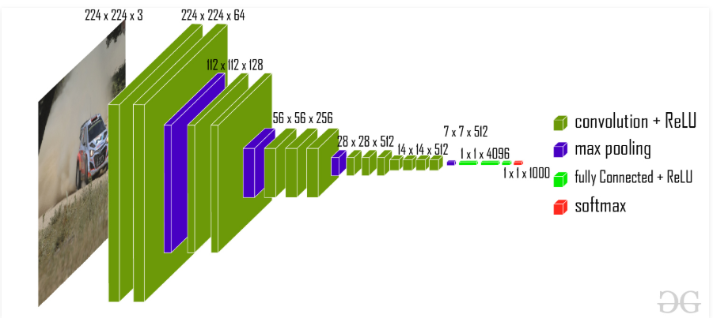
Vgg16

Slide 14
Search best parameter
We can modify batch size and epochs to adjust improve the training
l_batch_size=[25,50,100]
l_epochs=[25,50,100]
l_learning_rate=[0.001,0.01,0.1]
l_optimizer_name=[keras.optimizers.SGD,
keras.optimizers.RMSprop,
keras.optimizers.Adam,
keras.optimizers.Adagrad,
keras.optimizers.Adamax,
keras.optimizers.Ftrl]

Slide 15
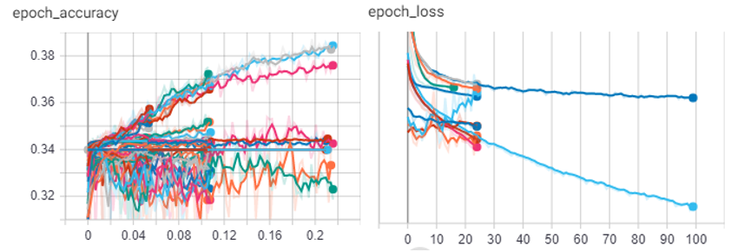
Summary of the current results

Slide 16
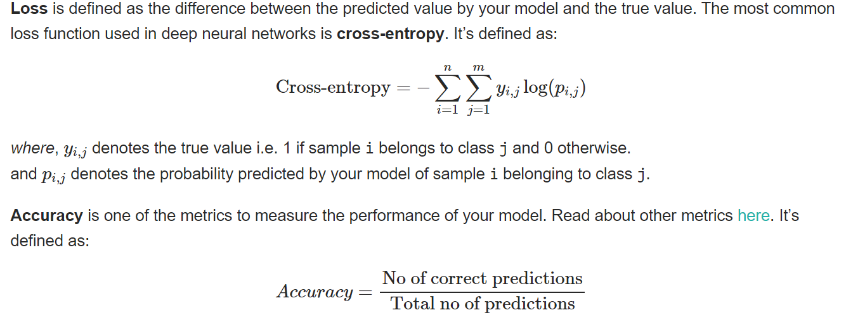
Loss vs accuracy
Source https://kharshit.github.io/blog/2018/12/07/loss-vs-accuracy

Slide 17
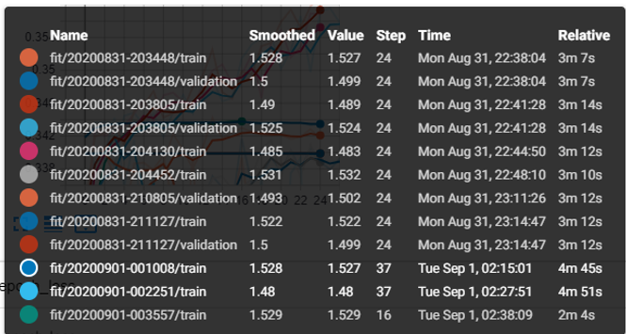

Slide 18
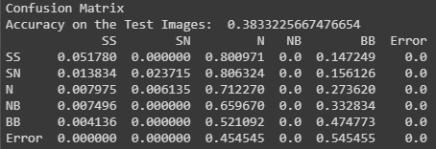
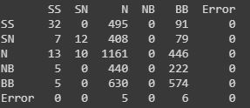
Validation
n
Check the validity of number of Neutral-Buy case in the test dataset or reshuffle it

Slide 19
API
Take an image of an historical graph from a market webpage like investing.com, crop the image to only fit the graph and save it to the ImageM/ folder for example with name image1.PNG or give the full path of the image when asked.
This execution tell us which market state in the future is the best representative.
Also we can get the future of all the graphs as an image in a directory and gives us the trading signals for a list of stock very quickly

Slide 20
Conclusion
The results of this study are a bit disappointing in terms of accuracy and confidence
For instance, to improve the model but after checking all the parameters I will be focusing on
get more dataset on stock (AAPL, MSFT) and indices (Nikkei, Eurostoxx, MSCI WORLD)
train the whole vgg16 this time untrained
apply to other CNN trained like AlexNet or Mask R-CNN
increase the size of input image from (32,32,32,3) to (256,256,256,3)
calibrate a generative adversarial network to increase dataset and self-fulfilling conclusion
Improving the dataset of the image to include the candlestick and volume for the series,

